Slide 1

MSoC Final Project
January 22, 2021
Reconstruction of Compressively Sensed Diagnostic Images Using HLS Solution
Presenter: Ting-Yang Chen, Yu-Cheng Lin, I-Hsuan Liu
Team#: 1
Graduate Institute of Electronics Engineering, National Taiwan University
https://github.com/linkingmon/ReconNet-hls
https://github.com/tingyungchen/ReconNet

Slide 2
Outline
Introduction
CT Images
Compressive sensing
ReconNet
Software simulation
HLS implementation
PYNQ implementation
Summary & Future Work

Slide 3
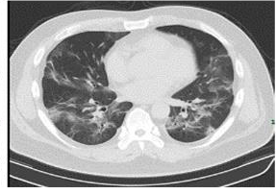
Diagnostic Images
Diagnostic images nowadays
CT, radiography and MRI images
Poor image quality produced in radiographic examinations
Much radiation exposure to patients through repeated radio graphic examinations, loss of diagnostic information
Solutions
Compressive sensing to reconstruct images from
underdetermined linear systems
Reducing patient dose and loss of information
Notes:
CT, radiography and MRI images
通常sensed完畢後是一個低解析度的圖片，甚至有些資料損失，透過CS可以解一個underdetermined linear systems 將圖片有效率的解回高解析度的圖片

Slide 4
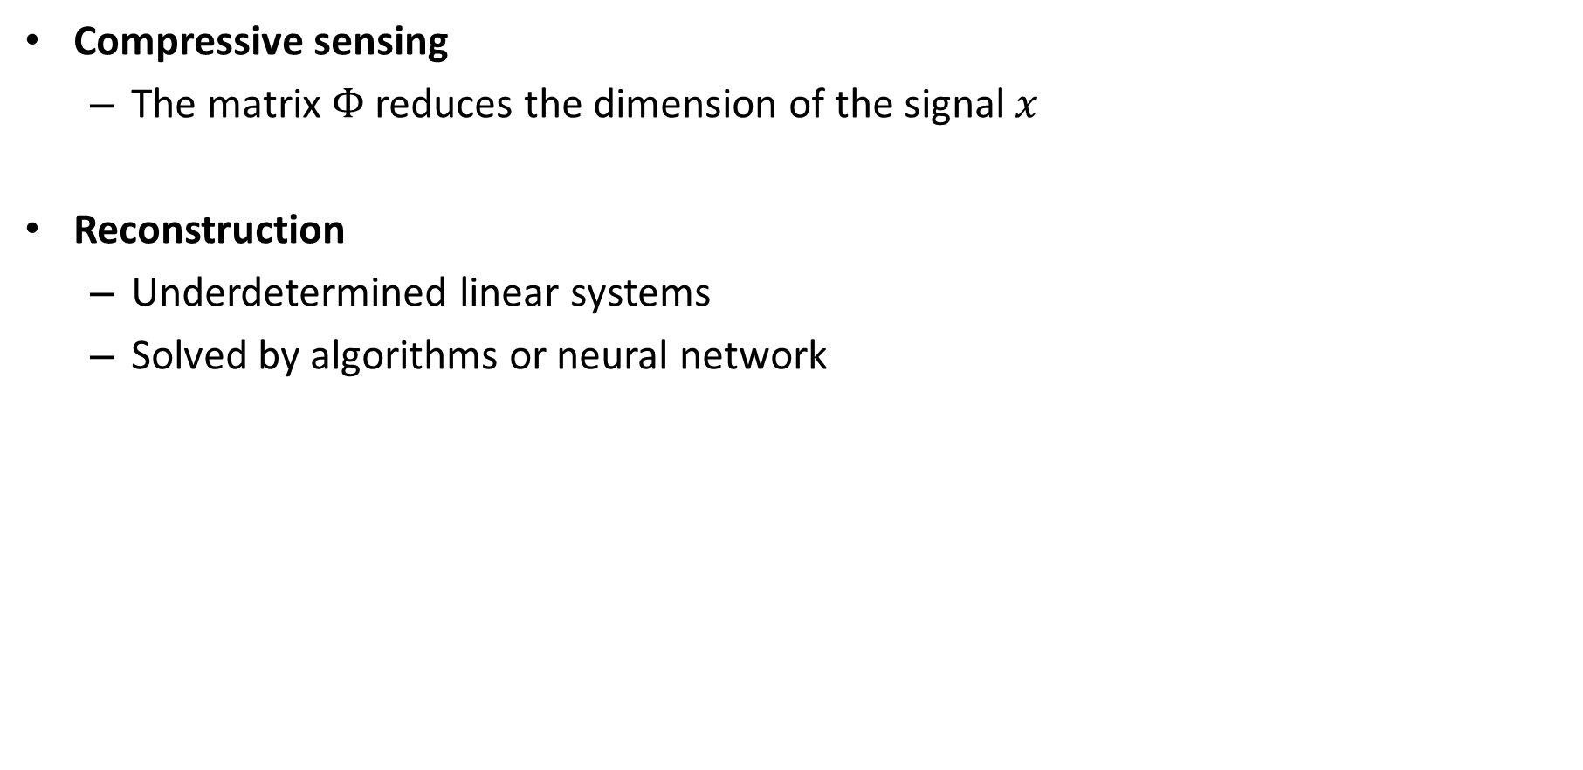
Compressive sensing
Compressive sensing
The matrix $Φ$ reduces the dimension of the signal $x$
Reconstruction
Underdetermined linear systems
Solved by algorithms or neural network
Notes:
如圖，x是輸入的訊號，可以是一維的訊號，例如心電圖或肌電圖等等的生理訊號，也可以是二維的訊號例如圖片。
Phi 是sensing matrix，x經過phi的轉換後可以將維度降低，也就是將訊號壓縮變成measurements y。如此一來，可以讓傳輸或是儲存的成本降低。
如果x經過某些domain轉換後可以表示成sparse vector, s，則可以說x是sparse。這些sparse transform可以是DCT,小波轉換等等，不同的訊號適合不同的sparse transform。
還原的部分，是一種Ill-posed inverse problems，也就是y想要還原回x的話，解答不只一種，這個問題可以使用演算法或是神經網路來解
(備用) Φψ仍保留Φ的特性這樣最好，the sensing matrix should be highly incoherent with sparsifying basis ψ
Φ具有隨機性，代表的是對輸入x還原品質的generality

Slide 5
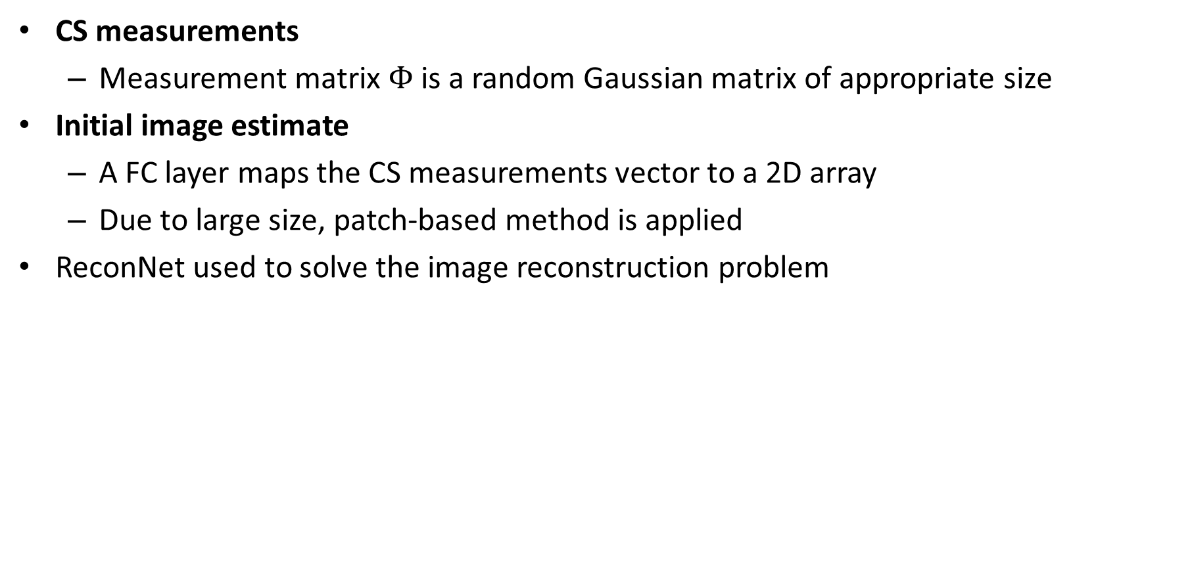
Reconstruction with ReconNet
CS measurements
Measurement matrix $Φ$ is a random Gaussian matrix of appropriate size
Initial image estimate
A FC layer maps the CS measurements vector to a 2D array
Due to large size, patch-based method is applied
ReconNet used to solve the image reconstruction problem
[1] S. Lohit, et al., Trans. Computational Imaging, 2018.
Notes:
這篇paper的想法是，使用nn取代過去的疊代方法，把nn視為一種演算法，他可以把CS measurement 還原成圖片或是原本的訊號。
這邊是使用non-overlapping的patch-based圖片輸入進去，原因有兩個，一個是training data可以增加，另一個是因為fc layer的size大，用patch的話比較不需要這麼多參數，33*33是在model size和還原效果取得平衡點決定的一個數值
(備用)
上圖架構要特別注意，輸入圖片經由CS轉換成measurments後，不能直接輸入後面的網路架構，因為這是一條col vector.
因此要先把他轉回一張粗估的圖片，才有辦法輸入nn。
這張粗估的圖片可以使用傳統的iterative approaches來得到，但是因為傳統的方法所需時間長，，因此這邊可以使用一層fc層
將CS measurement vector 轉2d array.
(備用) the block reconstructions are arranged to form an image and passed through a denoiser to remove the blocky artifacts and produce the final reconstruction
非patch-based演算法，phi因為參數過大很難學

Slide 6
ReconNet
Three convolutional layers
All intermediate feature maps are 33 × 33
ReconNet Unit
first convolutional layer - 11 × 11, generates 64 feature maps
second convolutional layer - 1 × 1, generates 32 feature maps
third convolutional layer - 7 × 7, generates the output block
ReLU is followed after each convolutional layer

Slide 7
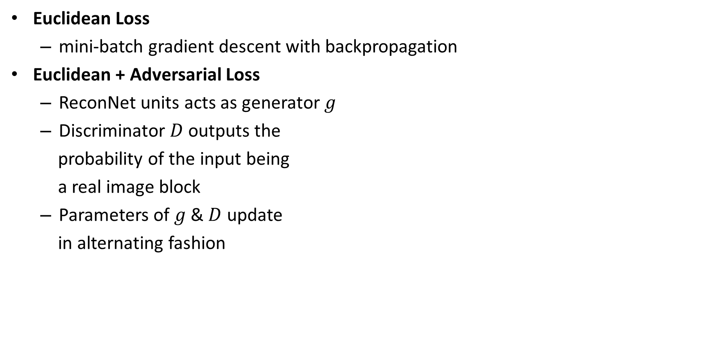
Loss Function of ReconNet
Euclidean Loss
mini-batch gradient descent with backpropagation
Euclidean + Adversarial Loss
ReconNet units acts as generator$g$
Discriminator $D$outputs the
probability of the input being
a real image block
Parameters of $g$ & $D$ update
in alternating fashion
Notes:
Loss function 有兩種，一種是單純的Euclidean loss，另一種是Euclidean loss又外加GAN的概念。我這邊分兩種講的意義是，在許多reconstruction的網路架構中，原本的loss function如果再補上Adversarial Loss，performance都很有可能再提高，像目前這個架構會提高1-2dB左右，所以可以把它看成一個獨立的東西，都可以補上。
可以看到第二個term是多加上去的，是discriminator的判斷generator出來是真的圖片，就必須給他penalty在generator上
注意Lce是binary crossentropy

Slide 8
Outline
Introduction
CT Images
Compressive sensing
ReconNet
Software simulation
HLS implementation
PYNQ implementation
Summary & Future Work

Slide 9
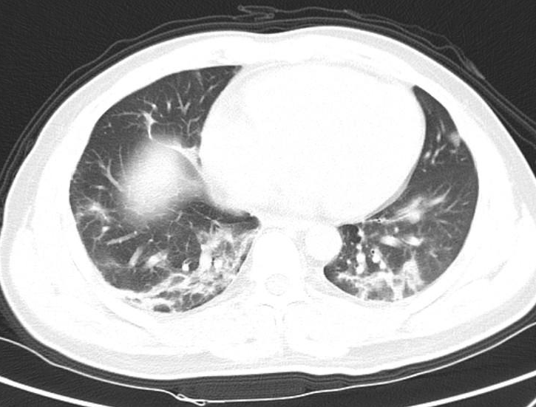

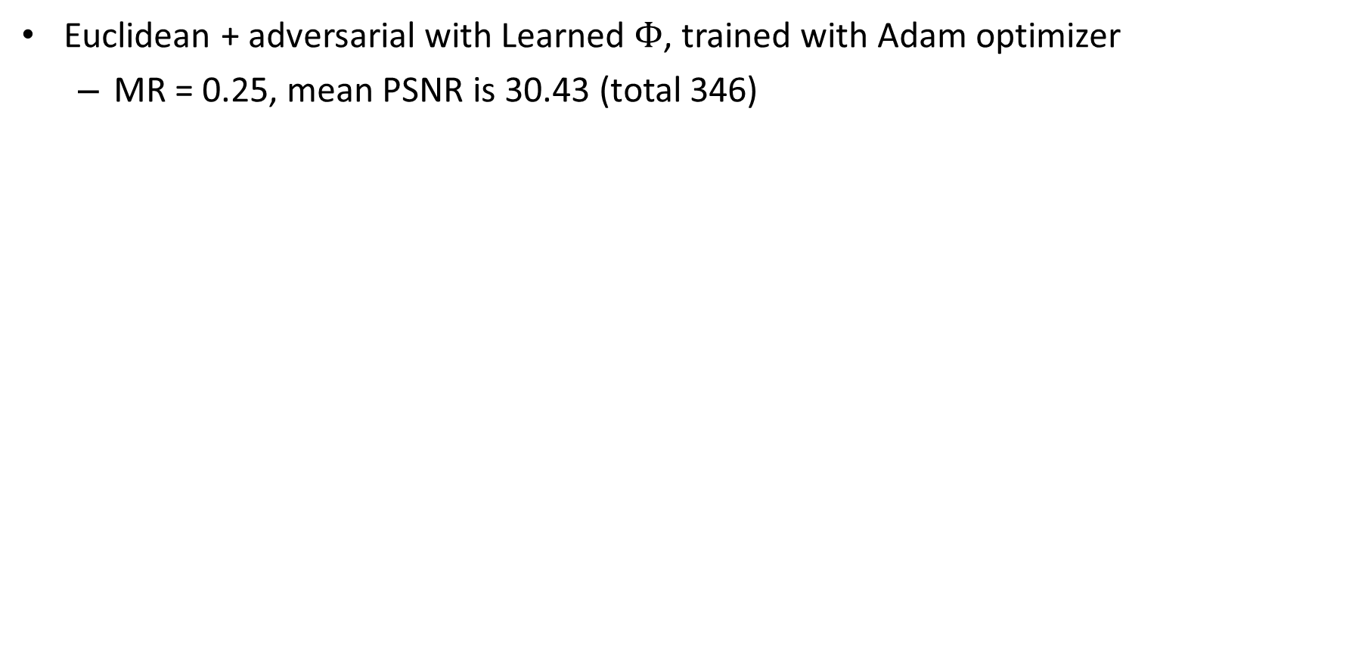
ReconNet Reconstruction (4x Reduction)
Euclidean + adversarial with Learned $Φ$, trained with Adam optimizer
MR = 0.25, mean PSNR is 30.43 (total 346)
Original
Reconstructed

Slide 10
Outline
Introduction
Compressive sensing
ReconNet
Software simulation
HLS implementation
HLS Workflow
Model quantization
Dataflow, streaming and line-buffer
Comparison Table
PYNQ implementation
Summary & Future Work

Slide 11
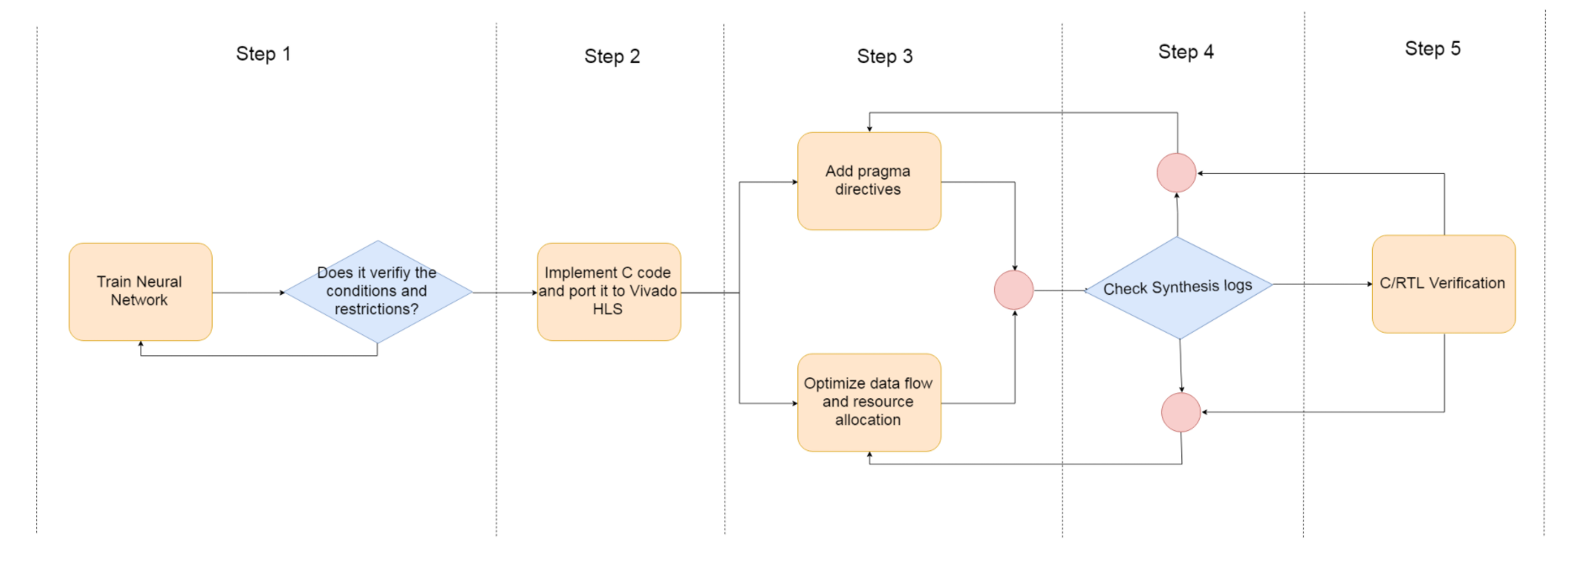
Workflow
Cosim cost several days, so we skip this step
All the works are our original work

Slide 12
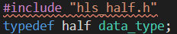
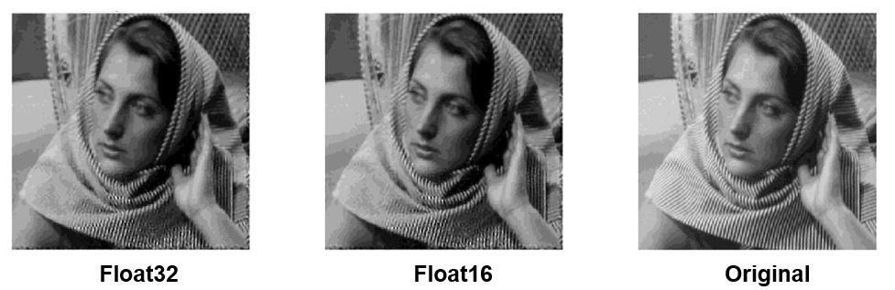
Model Quantization (1/2)
Fixed point arithmetic uses significantly fewer resources for basic operations and less memory usage
However, range of model weights and feature map varies from layers (Even 24 bit fixed point get poor results)
We use float-16 (1 signed, 5 exp, 10 mantissa) for implementation (Software verified)

Slide 13
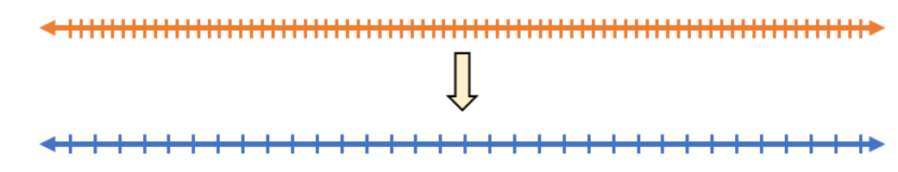

Model Quantization (2/2)
Post-training quantization
Reduce ReconNet model size
Reduce hardware resources
Simple linear equation applied
r is the real value (usually float32)
q is its quantized representation as a
B-bit integer(uint8, uint32, etc.)
S (float32) and z (uint) are the factors
by which we scaling and shifting
z is the quantized zero-point
$$r=S(q−z)$$

Slide 14
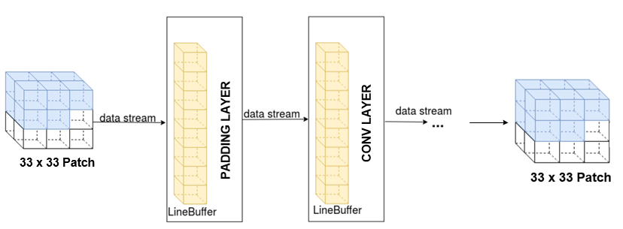
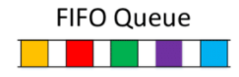
Dataflow pipelining
There are two main functions: Zero-padding & Convolution 2d
Dataflow pipelining the execution of convolutional
Don’t need to wait until all convolution completes
Data buffers (FIFO or PingPong buffer) were added in each layer
We choose FIFO for higher throughput and lower resources

Slide 15
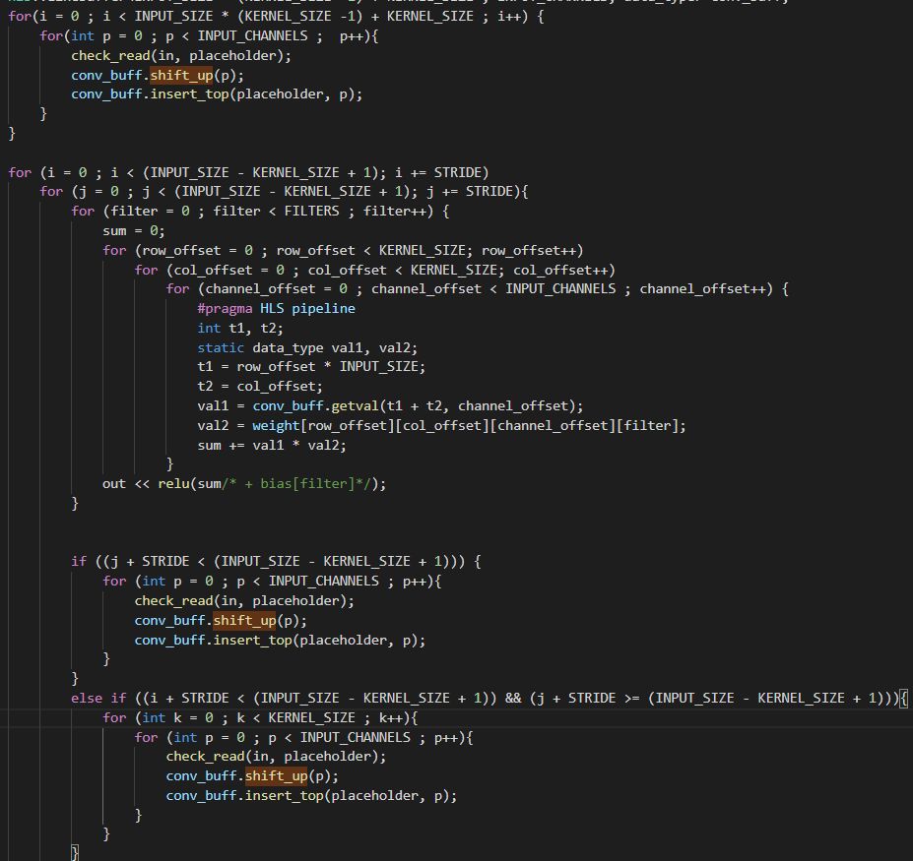
Line buffer for convolution operation
Read the initial data into line buffer
Do filtering
(Pipeline in the inner loop)
Pre-read data into line buffer if row ends

Slide 16
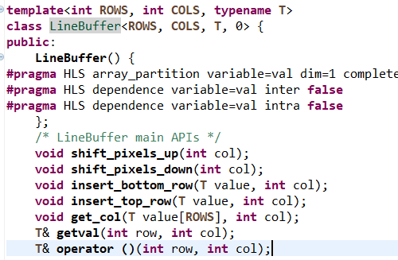
2D Line buffer Library
If the line buffer is specify as 1D (7712 x 1), the array partition number of layer2 (32 channel kernel 7)exceeds 1024 (error!)
We modified the Linebuffer to 2D (241 x 32), then the array partition number satisfies, however, the channel will be non-parallizable

Slide 17
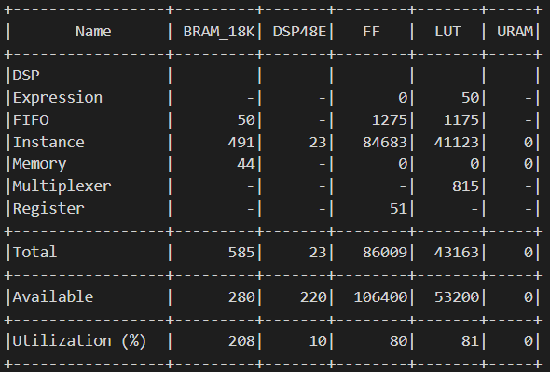
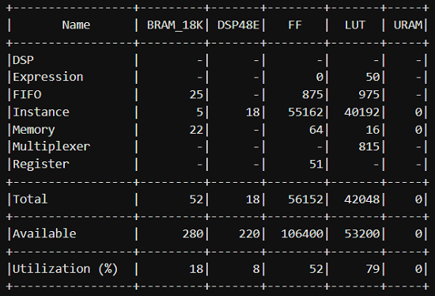
2D Line buffer Resource usage
The HLS results of 32 bit data type is as follows
By changing the datatype to half (float16), the non-parallel part is then realized by FF.

Slide 18
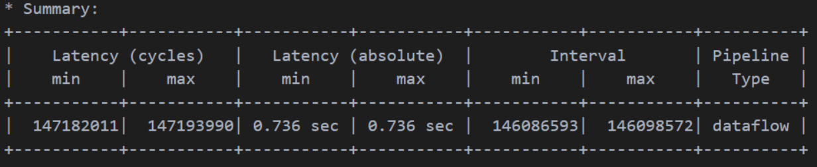
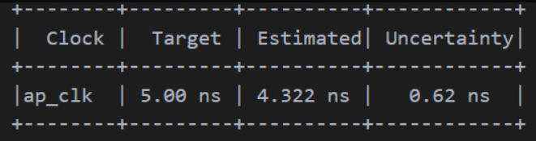
Comparison table
Final resources
Latency

Slide 19
Outline
Introduction
Compressive sensing
ReconNet
Software implementation
HLS implementation
PYNQ implementation
Top level architecture
Host program
Demo
Summary & Future Work

Slide 20
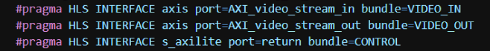
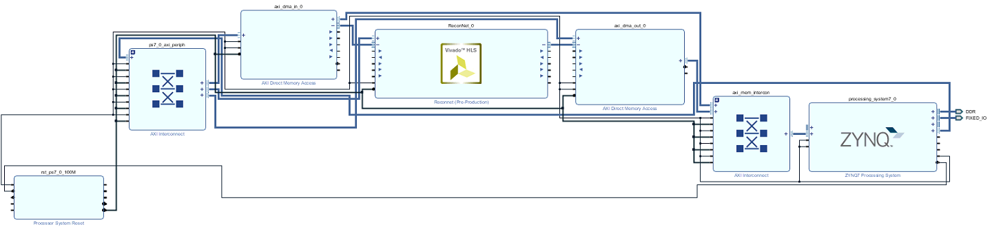
Top level architecture
Apply AXI stream as interface

Slide 21
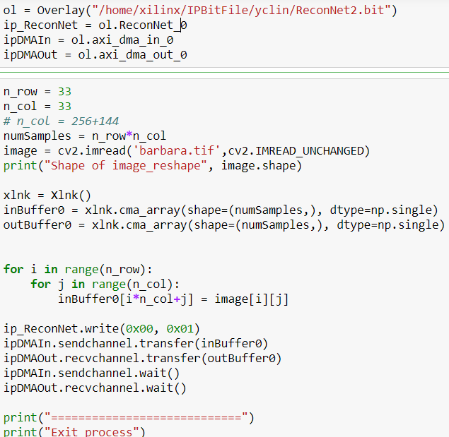
Host program
Read bit stream
Read input feature map
Store input feature map to Xlnk
Start Kernel and wait till DMA_out receive all values

Slide 22

Demo
Reconstruction of 256x256 image (4x transmission reduction)

Slide 23
Final Performance
Performance
Reach a reconstruction of PSNR over 30(dB) on CT image (Human cannot tell whether the image is real or fake by eye)
Hardware implemetation
The network require memory to store the weight (Weight stationary)
The image is streaming into and out of the submodule (streaming)
Utilize half data type to reduce resources while maintaining performance

Slide 24
Summary
Algorithms
Construct high resolution image by ReconNet
Slice full image into patches to reduce model size
Model Quantization make the solution more hardware efficient
HLS
Dataflow pipelining with data streaming
Utilize half data type to reduce resources while maintaining performance
Loop pipelining to speed up
FPGA implementation

Slide 25
Future Work
Real time high resolution video streaming (v.s. H.264)
Motion vector aided bypassing
Find Motion vector by motion estimation algorithms on low resolution picture and predict on high resolution picture
Enhance frame rate
Make the model more scalable

Slide 26
Reference
[1] S. Lohit, K. Kulkarni, R. Kerviche, P. Turaga and A. Ashok, "Convolutional Neural Networks for Noniterative Reconstruction of Compressively Sensed Images," in IEEE Transactions on Computational Imaging, vol. 4, no. 3, pp. 326-340, Sept. 2018

